Slide 1

Project Work-II (Emailer)
Internal Guide: Presented By:
Prof.(Dr.) Ruchi Patel Somya Salgia
External Guide: (EN16CS301265)
Mr. Neelesh Jain

Slide 2

Details about the Internship
Organization – Hvantage Technologies Inc., Indore
Industrial Training Duration – 5 Months
Start Date – January 1, 2020 – May 31, 2020
Role – Java Application Development Intern

Slide 3
Roles and Responsibilities
Web Application Development-
Frontend Part – Designing web pages for the application.
Backend Part – Handling the functionality behind the application including connectivity between pages and API handling.
Database Management
Google Spreadsheet Automation –
Automate Google spreadsheet by adding functionalities which work on triggers when certain conditions meet.
Data Flow Documentation

Slide 4
Projects Handled
Emailer – Problem Domain
Previously when different companies have to Email marketing or digital marketing it’s a very tedious process because one has Select the list of customer and then design the content of email of email manually.
Also, he or she has to attach the template which is to be send by first designing or downloading it from other sources and then send it by attaching it one by one manually to all the other user or customer which is a very tedious process.

Slide 5
Projects Handled
Emailer – Solution Domain
Emailer is tool where the user can design his or her template on the same platform and can send it to the attached customer list simultaneously.
User can not only send his or template but also store it in our database for further uses. Also he/she can also edit these templates according to him.
User can manage Google Spreadsheet by importing it can export the template present in our system or application to the spreadsheet.
User can design Google forms for Surveying and can also export any customer list in CSV format.
User can also send SMS using SMS API to various customer present in customer list.
User can also import Google contacts present in his or her Google Gmail id and can prepare customer list.

Slide 6
Projects Handled
Emailer - Description
This project is an implementation to solving the problem statement regarding Email Marketing Campaign issues.
This project is an application which has four type of user access to it including Super Admin, Business Admin Template Sender and Template Creator.
Here, there are various functionalities including Template Management where user can create template,Similarly for Template Creator
The application has Google Log-in capabilities for which we have used Google API’s and Google Auth 2.0.
There are functionalities to make several business accounts to which specific users can be mapped to and those business accounts are able to handle all business admins.
We have added SMS Management functionalities where the users can also do SMS Marketing along with Email Marketing.

Slide 7
Technologies Used
Front-end – HTML, CSS, Bootstrap, JavaScript, jQuery
Back-end – Java, JSP
Database – MySQL
Framework – Maven Framework
Server – Apache Tomcat 9
Tools used – NetBeans IDE, MySQL Workbench

Slide 8
Google Apps Script
Apps Script is a scripting platform developed by Google for light-weight application development in the G Suite platform. Google Apps Script was initially developed by Mike Harm as a side project whilst working as a developer on Google Sheets. Google Apps Script was first publicly announced in May 2009 when a beta testing program was announced by Jonathan Rochelle, then Product Manager, Google Docs. In August 2009 Google Apps Script was subsequently made available to all Google Apps Premier and Education Edition customers. It is based on JavaScript 1.6, but also includes some portions of 1.7 and 1.8 and a subset of the ECMAScript 5 API. Apps Script projects run server-side on Google's infrastructure. According to Google, Apps Script "provides easy ways to automate tasks across Google products and third party services." Apps Script is also the tool that powers the add-ons for Google Docs, Slides, Sheets etc.

Slide 9
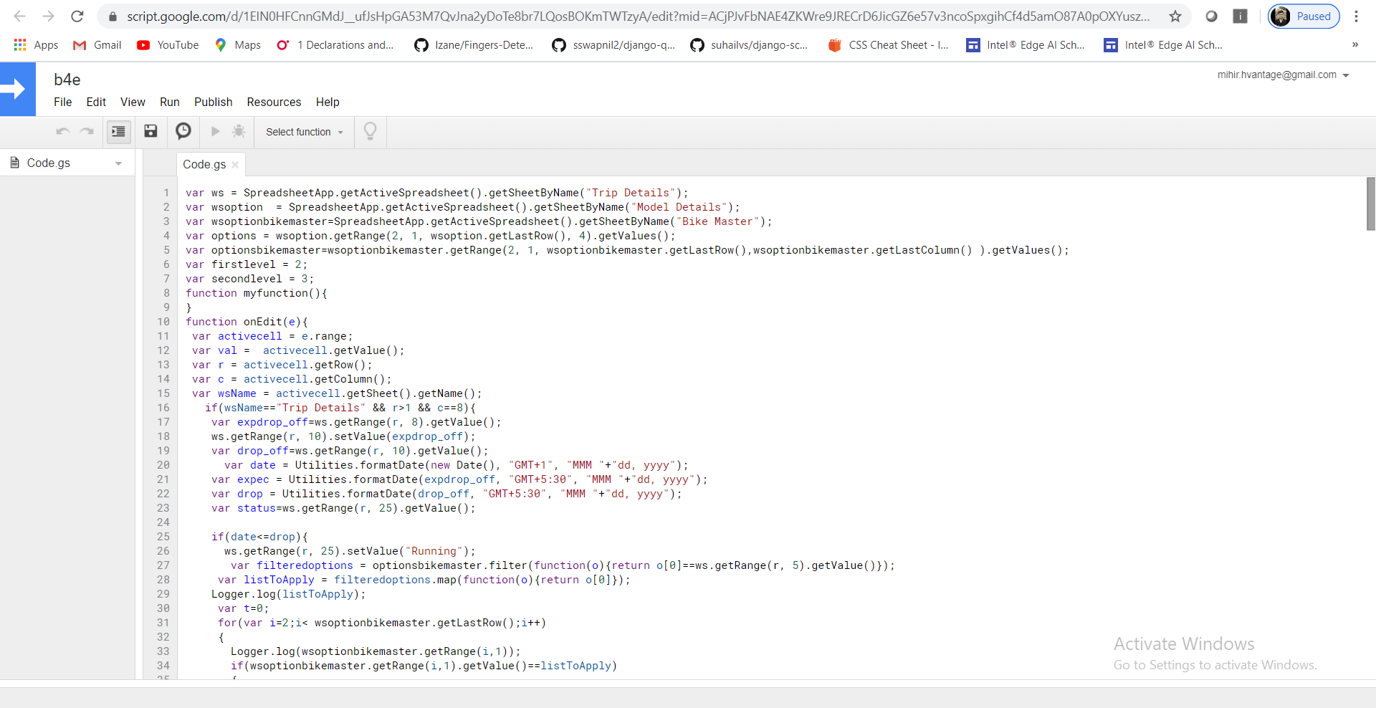
Screenshots

Slide 10
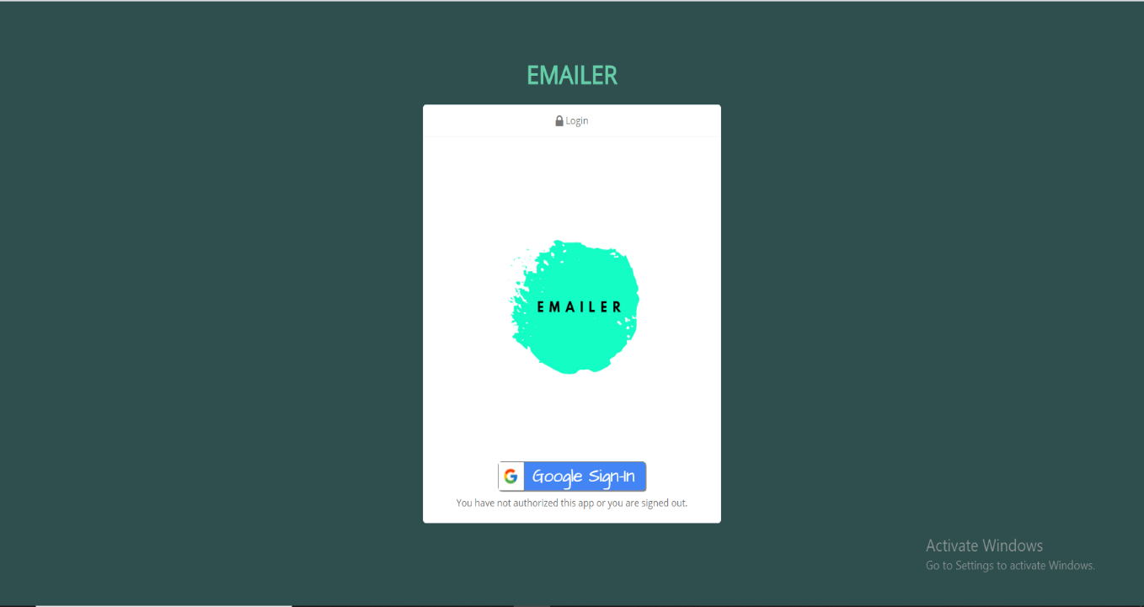
Screenshots

Slide 11
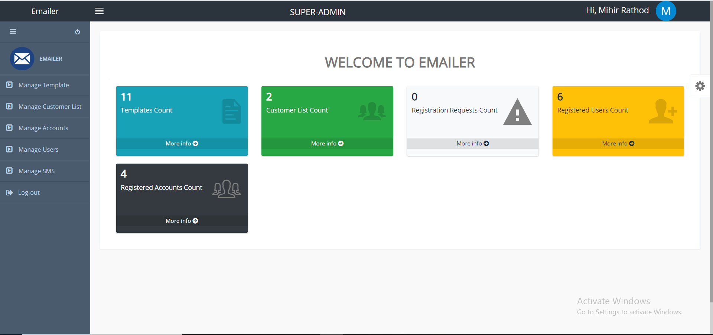
Screenshots

Slide 12
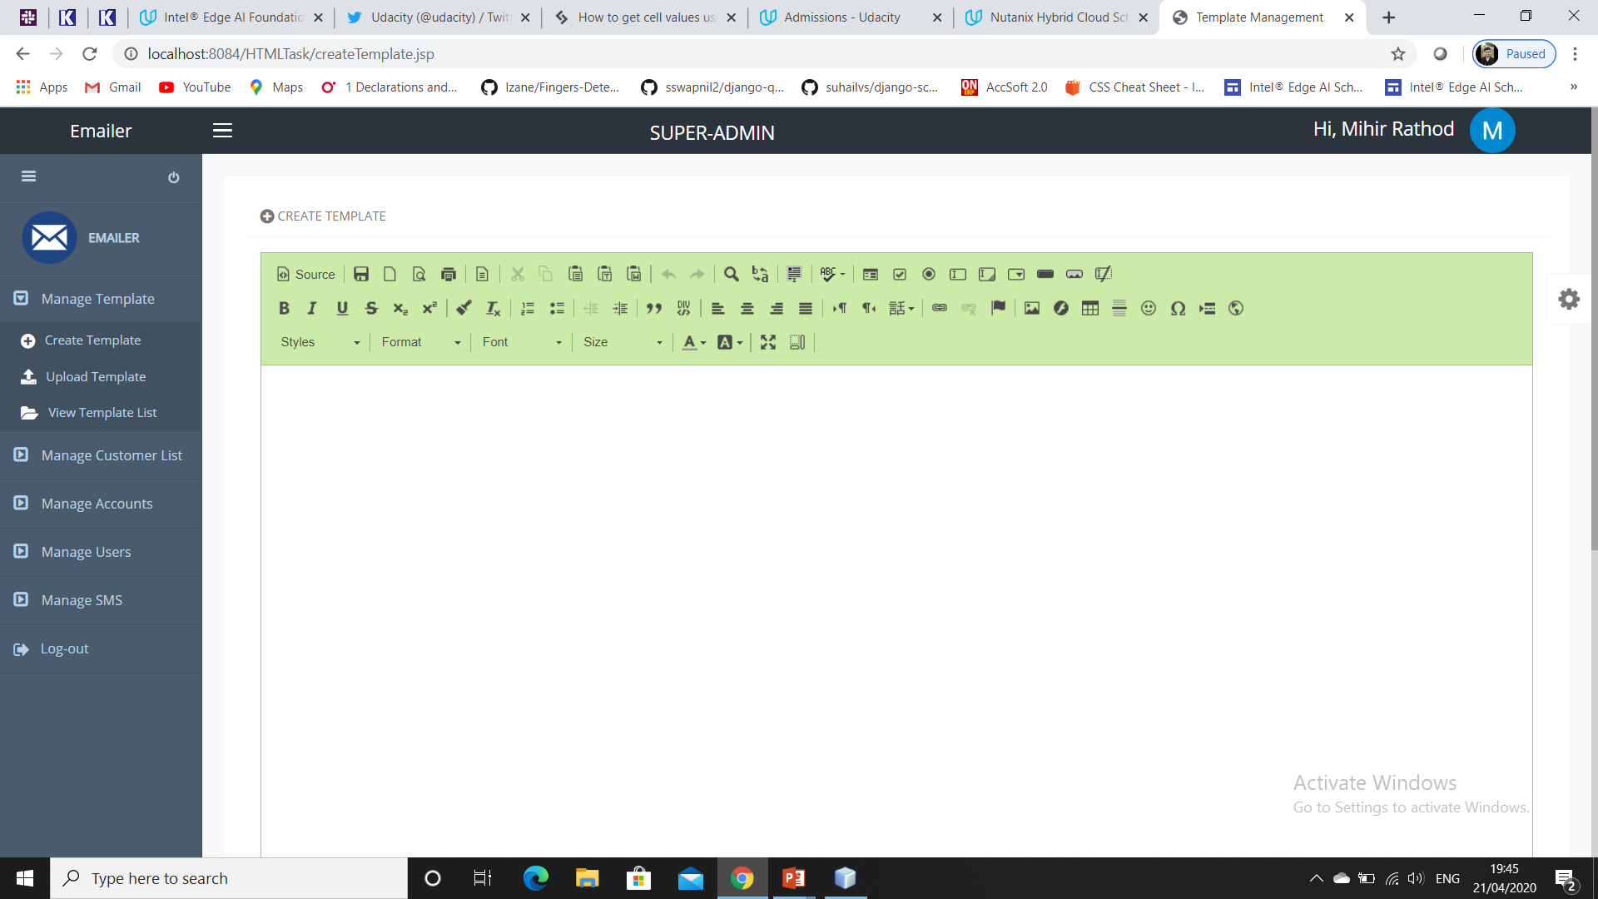
Screenshots

Slide 13
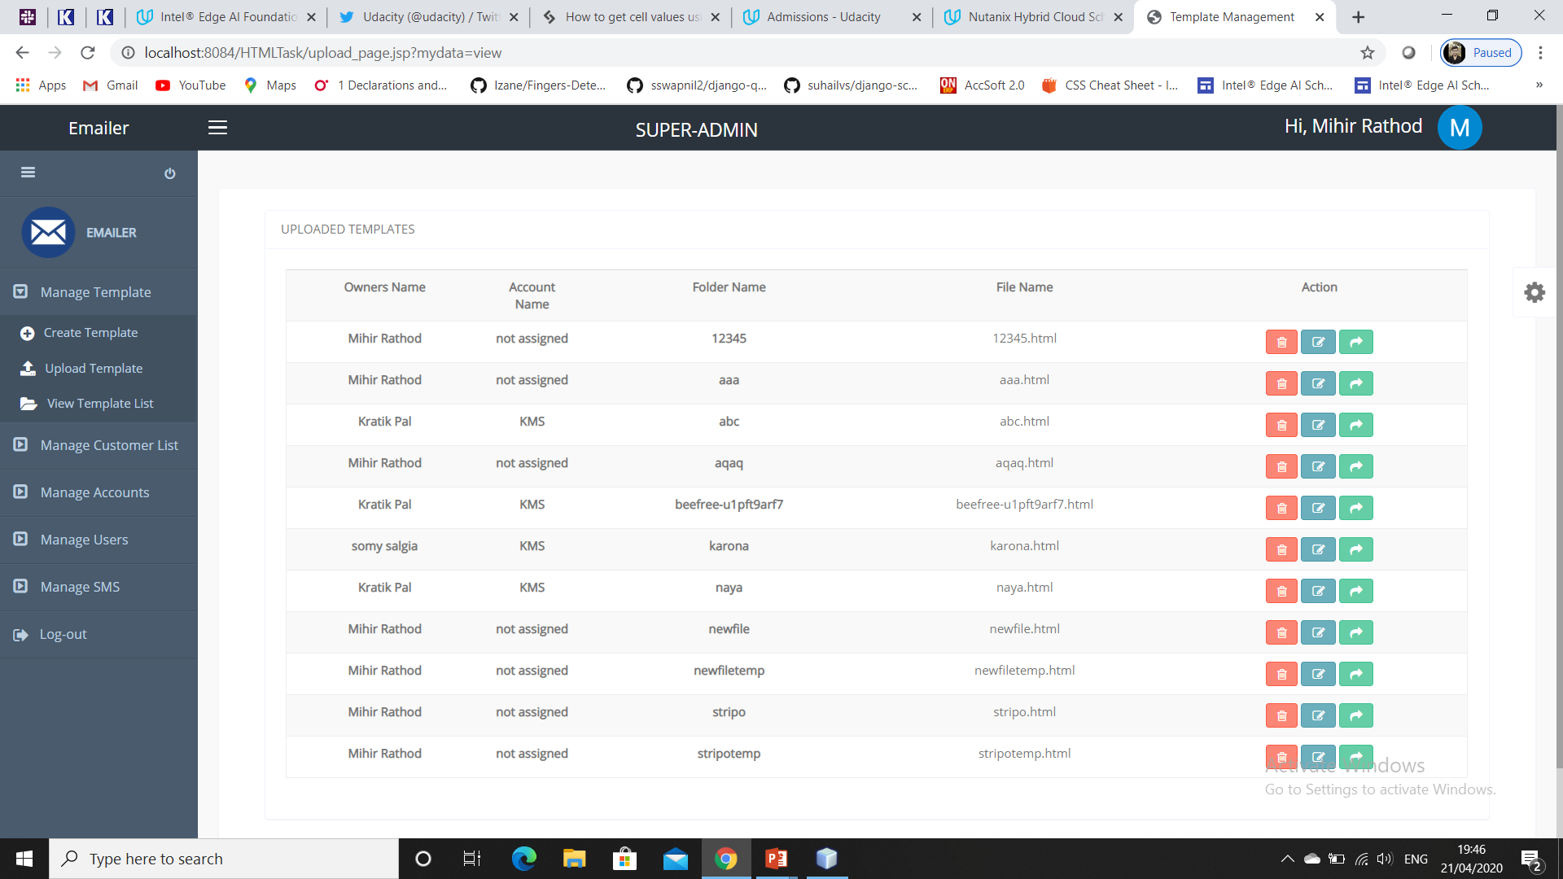
Screenshots

Slide 14
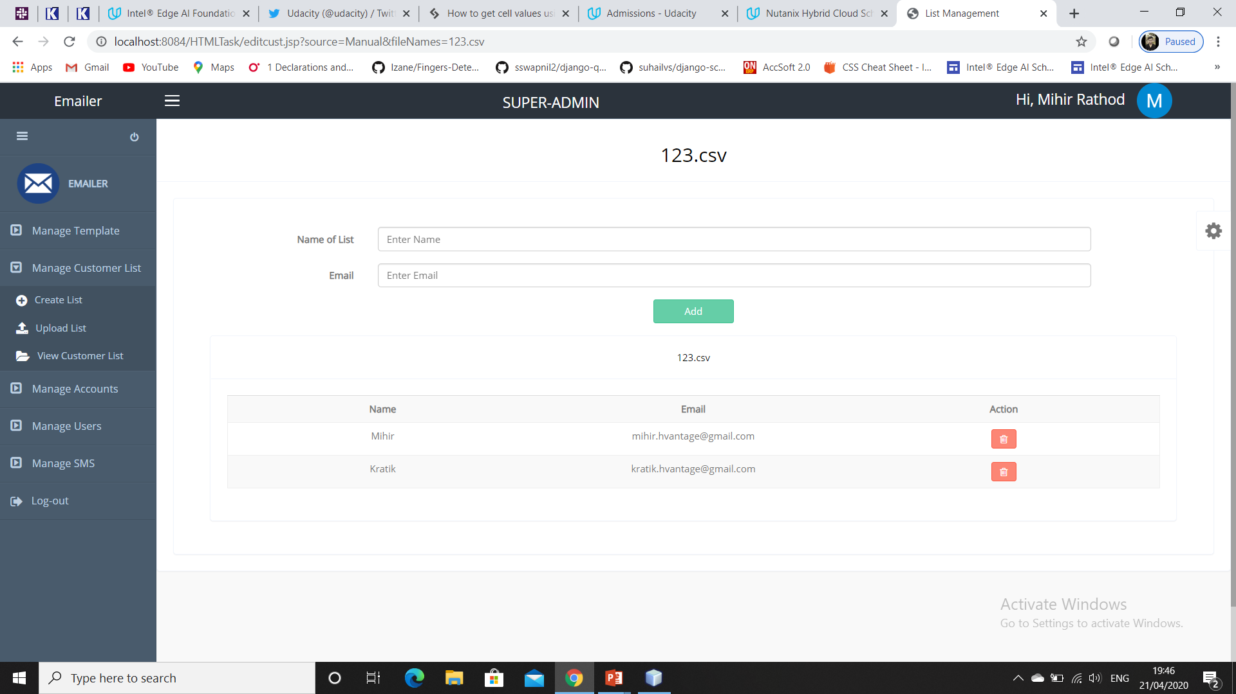
Screenshots

Slide 15
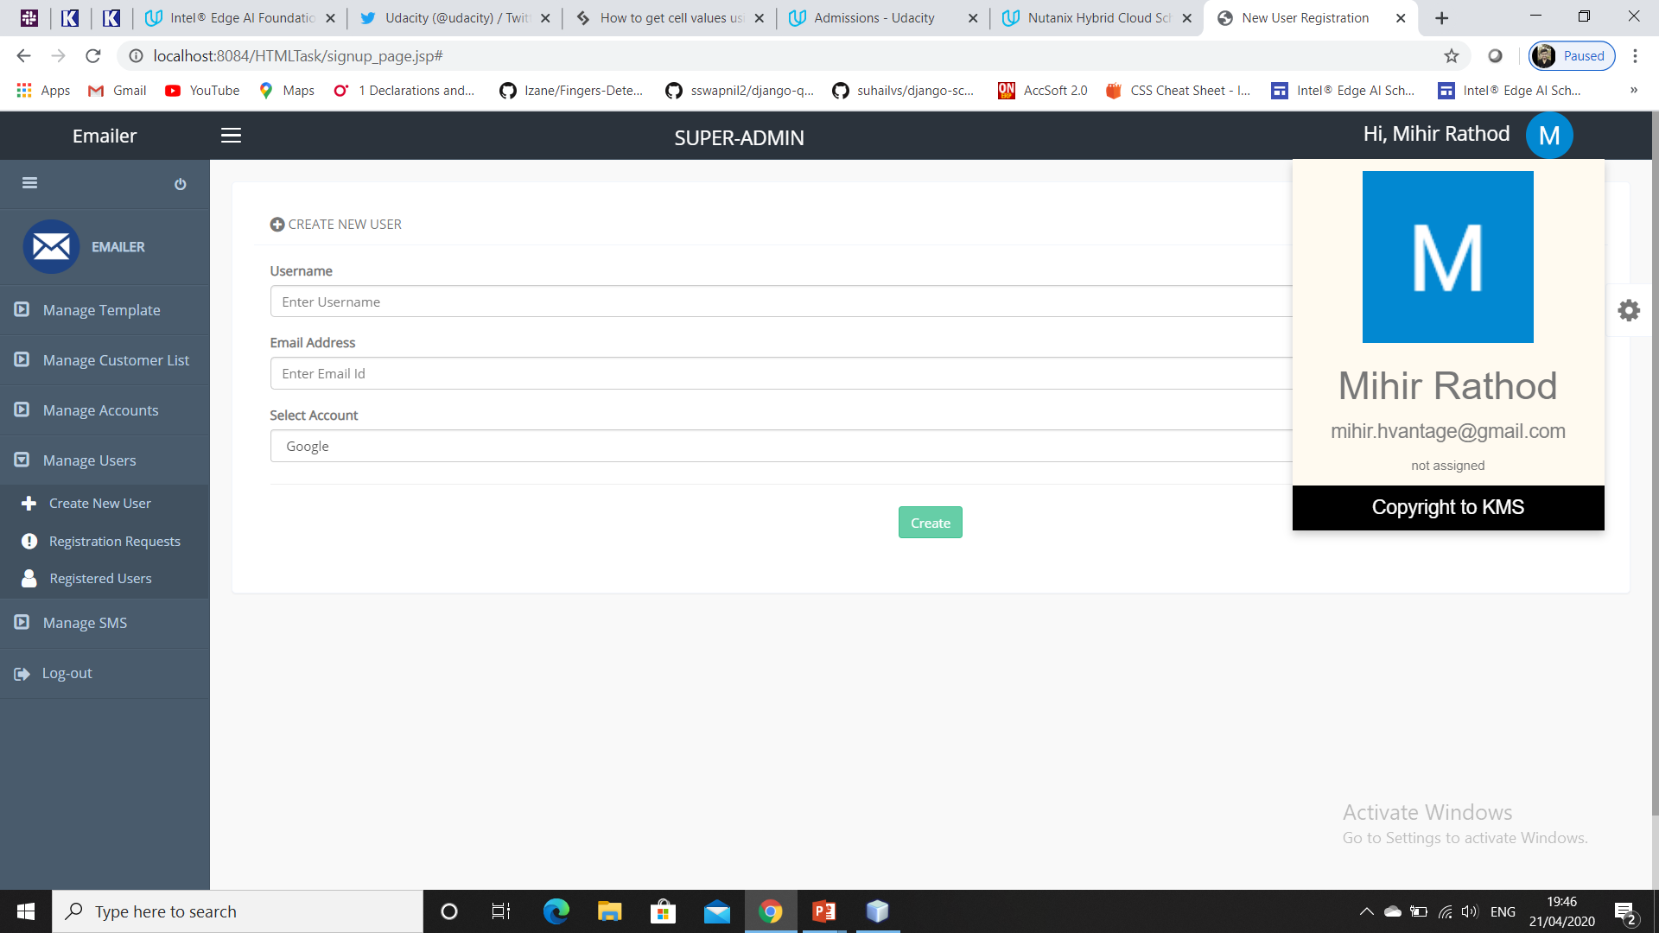
Screenshots

Slide 16
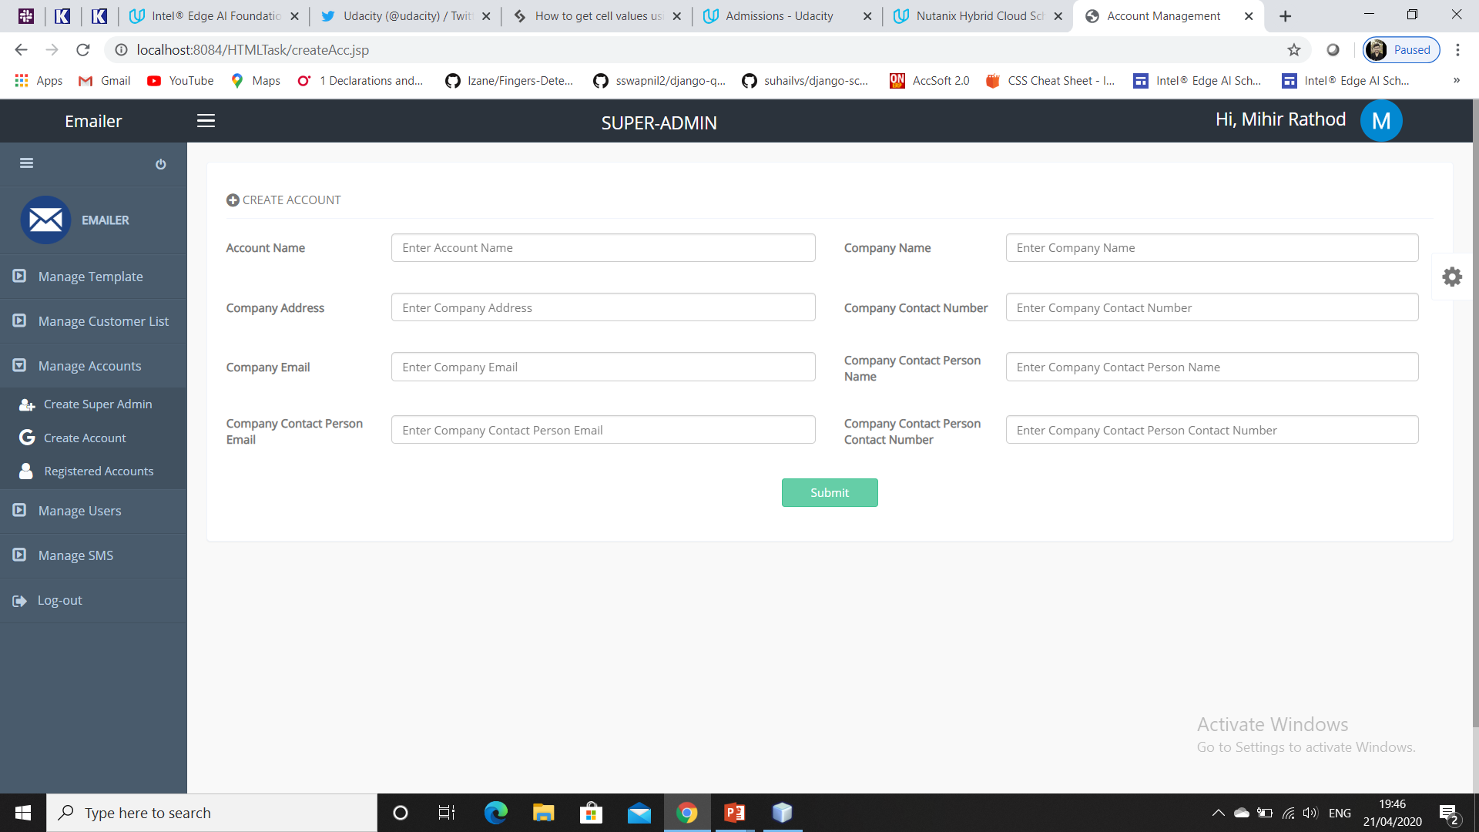
Screenshots

Slide 17
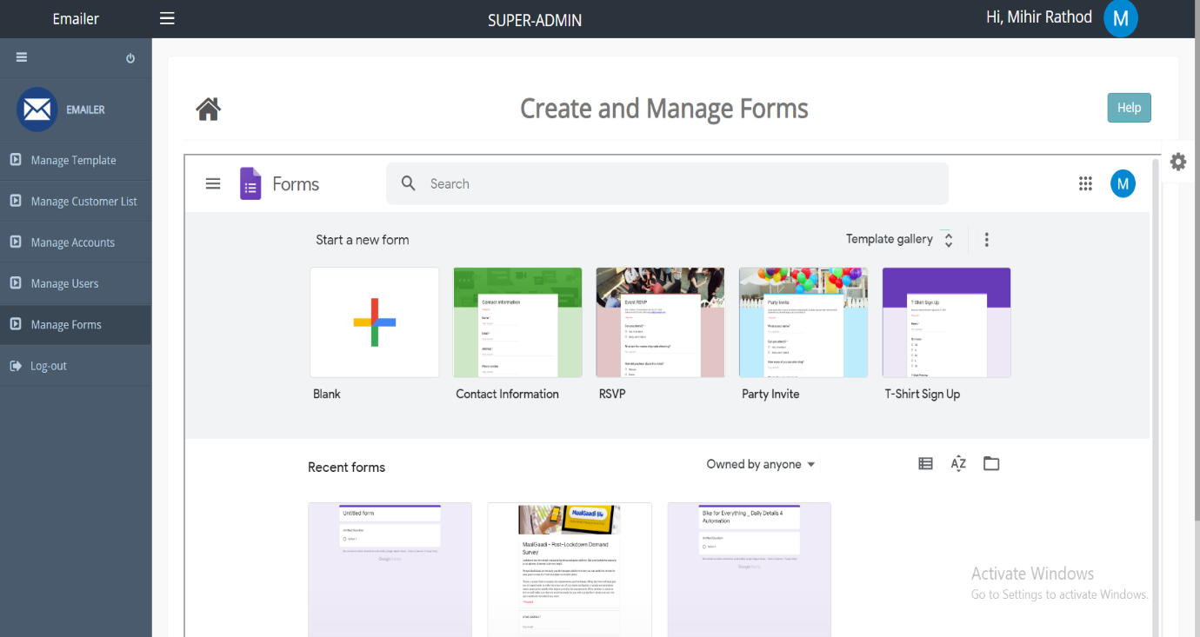
Screenshots

Slide 18
Future Scope
Payment Options: Add different payment options such as PayPal, Cash,. Allow to save payment details for future use.
Sms Credit section through which users can view sms credits.
Adding Multiple Attachment options to template.

Slide 19
Thank You

